Slide 1


Slide 2
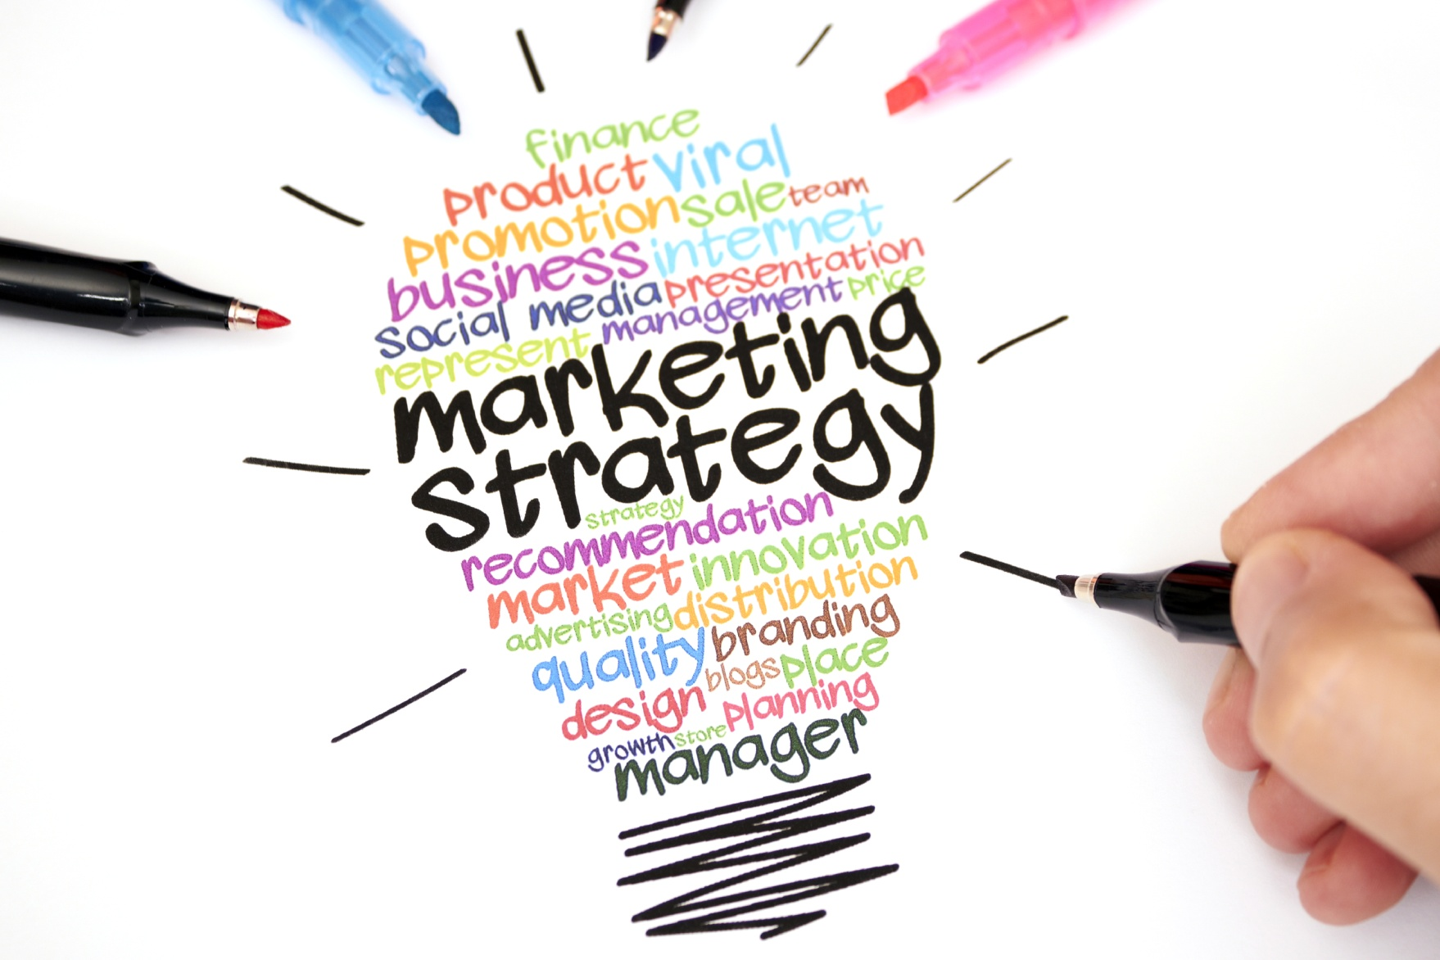
MARKETING STRATEGY

Slide 3
Corporate
Direct Email to HRs’ of identified companies within reach
Audience: HR of banks, microfinance banks, IT companies and other private organisations
Channel: Email
Requirements: Corporate profile, introductory email, Email addresses of the identified companies, team photo
Cost of Requirement: 10,000naira for professional team photo

Slide 4
Corporate & Social
2. Attending Events, Fares & Exhibitions (At least one event per month)
It would also be a great avenue to meet interact and create relationships with other companies in the industry that may require our services, and also meet people that might become prospective client.
Audience: Companies, individuals
Channel: Face to face interactions
Requirements: Business cards, information on upcoming events, Transportation costs to event venue
Cost of Requirement: 4000naira per month on tfare, Registration cost(where applicable)

Slide 5
Corporate & Social
3. Individual Marketing
Engage people to market with the agreement of giving 10% on every sealed deal
Audience: Companies, individuals (youths btw 23-35)
Channel: One-on-One
Requirements: Marketers
Cost of Requirement:

Slide 6
Social
4. Social Media:
Web banner promo ad; Web listing of business; Instagram post (at least times weekly); Facebook posts (at least four times weekly); Twitter daily tweets; WhatsApp updates;
Audience: Individuals (youths btw 23-35), Middle aged people
Channel: Instagram, Facebook, Twitter
Requirements: Banner designs, promo fees, business listing fee, contents and pictures for posting, data
Cost of Requirements:

Slide 7
Corporate & Social
5. Maintaining good relationship with past clients and vendors. Sending them messages at least once a month. Celebrating them on social media. Update their contact info on the database. Send gifts when necessary.
Audience: Clients and Vendors
Channel: Phone calls, text messages, emails, social media pages
Requirements: Call cards, Data
Cost of Requirements: 2500naira monthly

